Slide 2




Real time signals
TCP
ex: $d_{relative},v…$
Critical information
Desired acceleration
ACC command

Slide 3
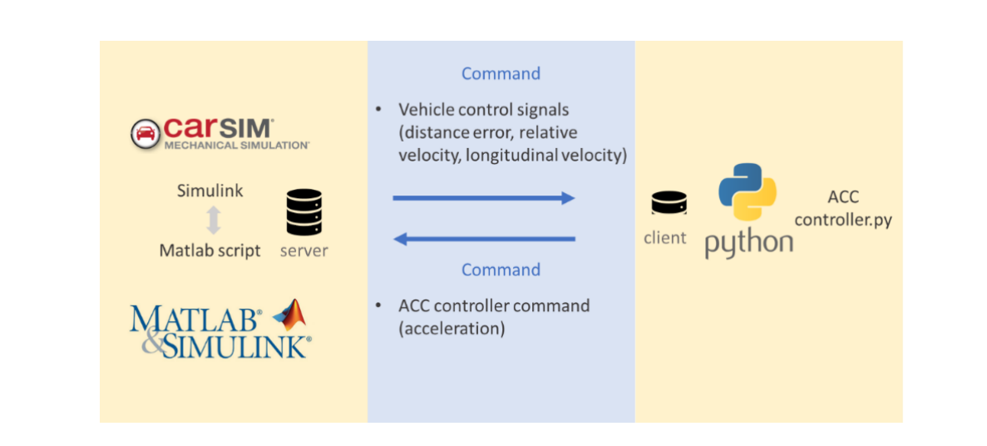

Slide 4










Realistic system
input $u_{k}$
output $y_{k}=\left[\begin{aligned}∆d \\ ∆v \\ a_{f}\end{aligned}\right]$
MPC(optimization)
Realistic system
input $u_{k}$
output $y_{k}=\left[\begin{aligned}∆d \\ ∆v \\ a_{f}\end{aligned}\right]$
MPC(optimization)
Send back $u_{k}$
Sampling time: $from k to k+P−1$
Initial condition: $y_{k}$
Optimize $\min{L(y_{k+i+1|k},u_{k})}$
Input: ${\{u}_{k},u_{k+1},u_{k+2},……,u_{k+p−1}\}$
System model (simplify to linear)
output: ${{\{y}_{k+1},y_{k+2},y_{k+3},……,y_{k+p}\}}_{virtual}$

Slide 5







Realistic system
output $y_{k}=\left[\begin{aligned}∆d \\ ∆v \\ a_{f}\end{aligned}\right]$
input $u_{k}$
MPC (controller)
Time horizon: 𝑃−1
Send back $u_{k}$
Optimize $\min{L(y_{k+i+1|k},u_{k},∆u)}$
Input: ${\{u}_{k},u_{k+1},u_{k+2},……,u_{k+p−1}\}$
System model
output: ${{\{y}_{k+1},y_{k+2},y_{k+3},……,y_{k+p}\}}_{virtual}$
Initial condition: $y_{k}$

Slide 6


$$error$$
L1
$$error$$
$$k$$
$$k+p−1$$
$$t$$
Minimize the color area
L2
$$error$$
$$k+1$$
$$k+p$$
$$t$$
L3
$$k+2$$
$$k+p+1$$
$$t$$

